Slide 1
WE ARE SCHOOL SPORT
EMPOWERING YOUTH THROUGH SPORT AND EDUCATION
ISF GYMNASIADE 2024
SWIMMING
Alexis Kyriakides
ISF Swimming Technical Committee President

Slide 2
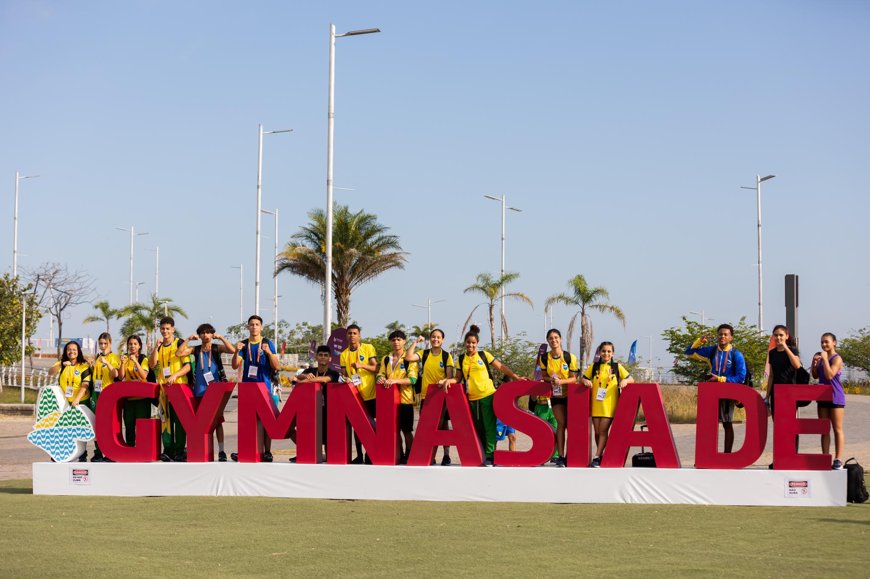
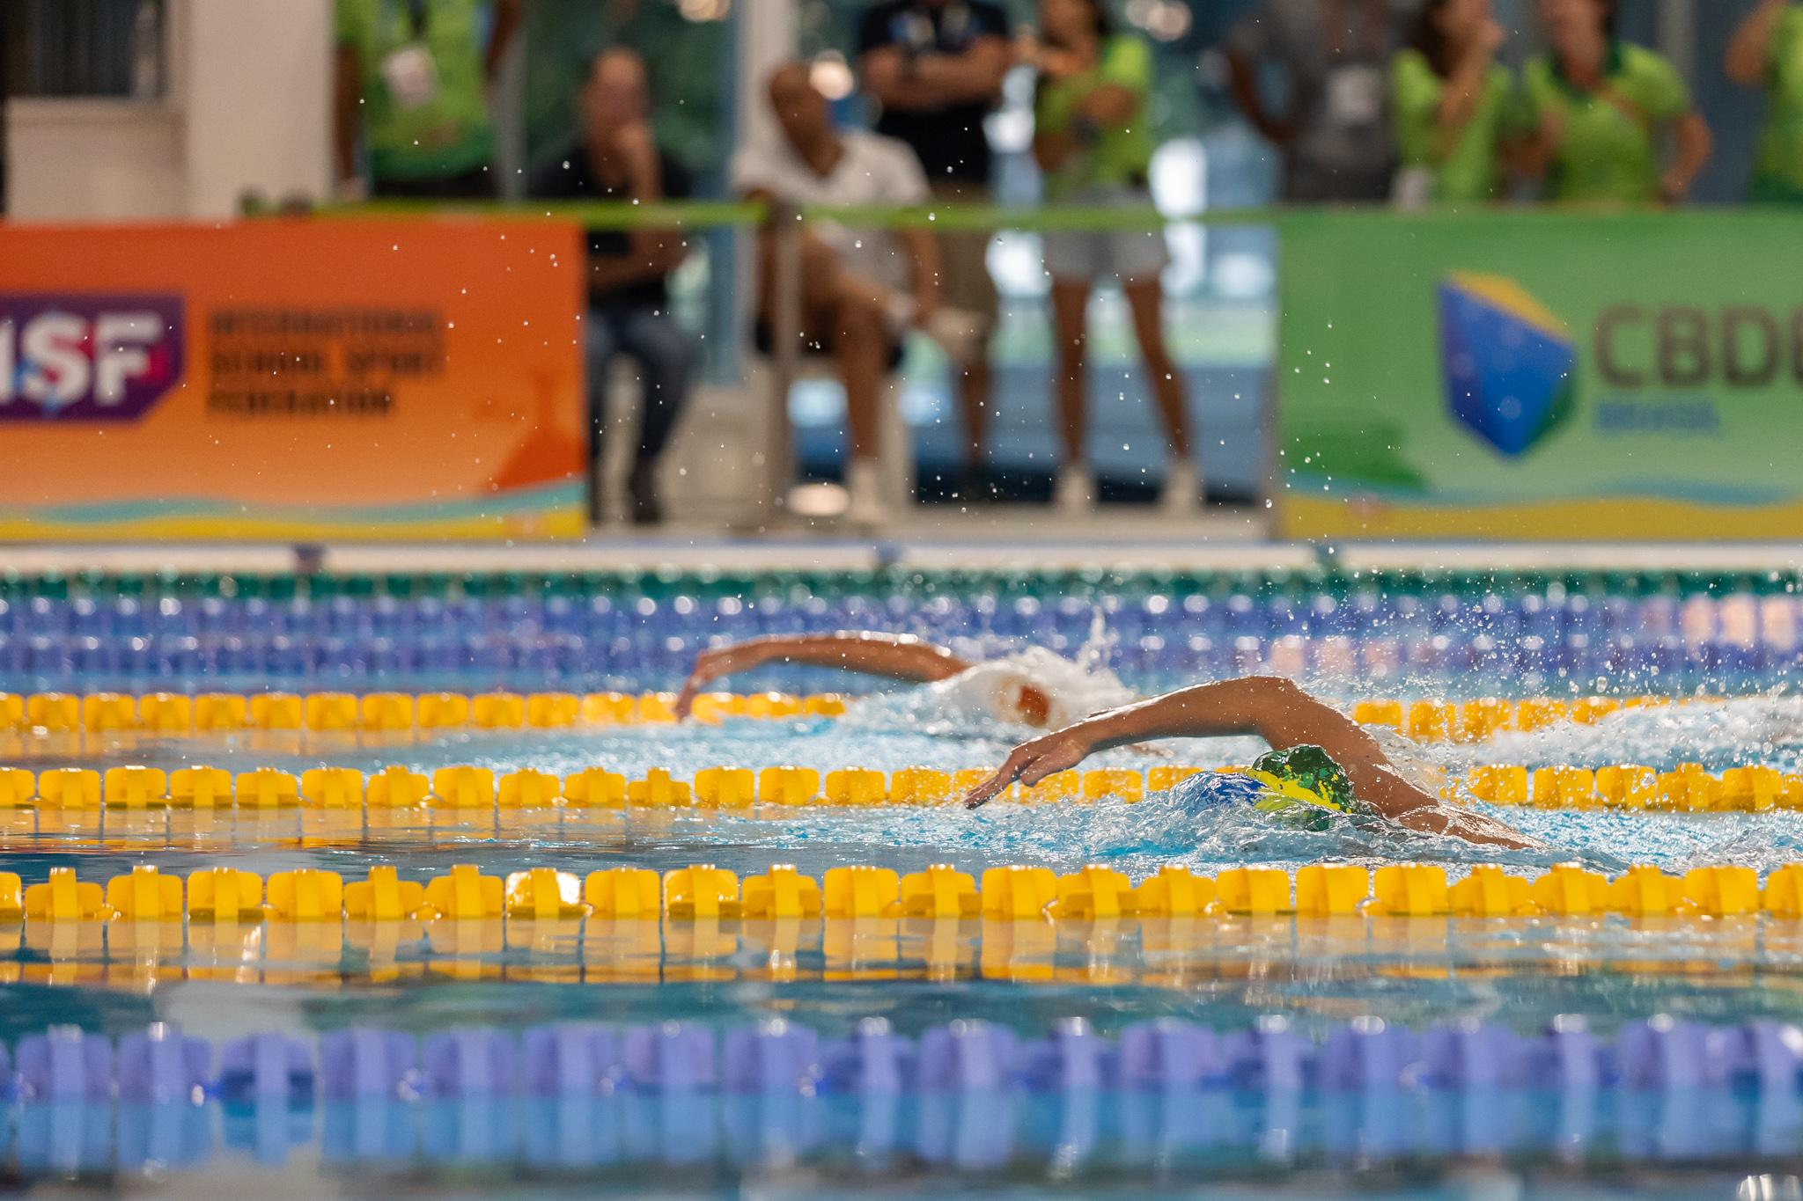
Swimming: A Global Sport
-The ISF World School Gymnasiade is a prestigious international sporting event that features a variety of competitions, including swimming.
-ISF Gymnasiade is a unique event that brings together students from all over the world to compete in a variety of sports. This provides students with an opportunity to meet new people, learn about different cultures, and make lifelong friendships.
-Swimming is an important part of the ISF Gymnasiade because it fosters athleticism, promotes teamwork, and encourages sportsmanship.
8
Notes:
Swimming is a global Sport.
-The ISF World School Gymnasiade is a prestigious international sporting event that features a variety of competitions, including swimming.
-ISF Gymnasiade is a unique event that brings together students from all over the world to compete in a variety of sports. This provides students with an opportunity to meet new people, learn about different cultures, and make lifelong friendships.
-Swimming is an important part of the ISF Gymnasiade because it fosters athleticism, promotes teamwork, and encourages sportsmanship.
Participation in global swimming events can be a very rewarding experience for student-athletes. These events can provide students with a unique opportunity to compete against the best swimmers in the world, learn from experienced coaches and athletes, and experience different cultures. They can also help students to develop important life skills such as perseverance, discipline, and resilience.
In addition, participation in global swimming events can help students to become more well-rounded individuals. These events can help students to develop a global perspective and learn about different cultures. They can also help students to develop a stronger sense of self-confidence and learn how to deal with adversity.
.

Slide 3
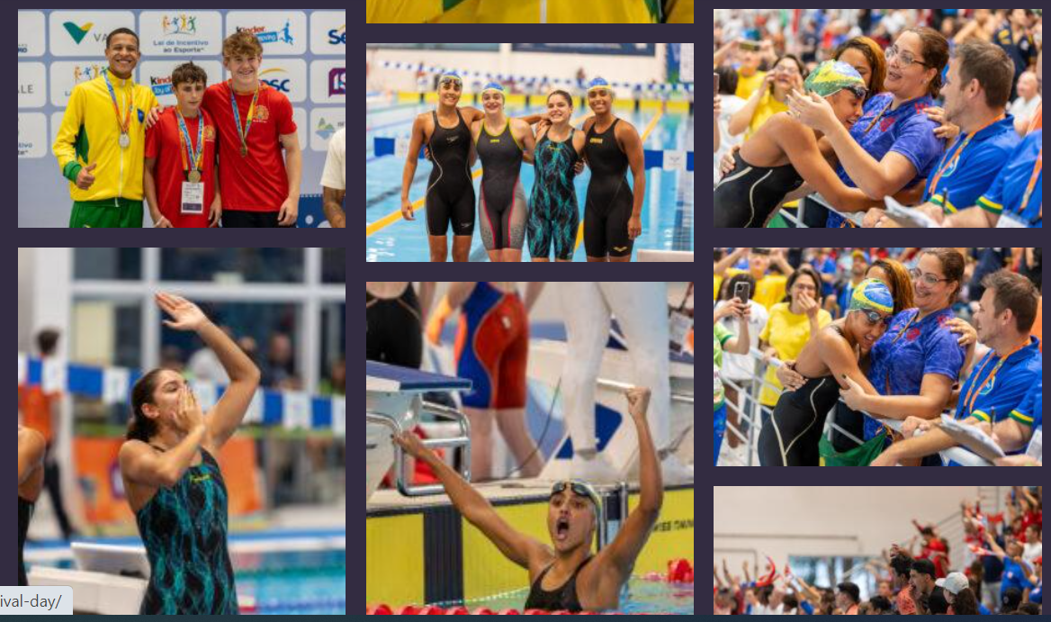
Swimming at the Gymnasiade Participation Benefits
-Improved athletic performance
-Increased motivation and dedication
-Enhanced self-confidence
-Greater cultural awareness
-Improved teamwork and communication skills
-Increased opportunities for scholarships and grants
-Exposure to different training methods and techniques
-Development of lifelong friendships
Notes:
Let's see the most important benefits for students’- athletes by participating in International Swimming events such as the ISF Gymnasiade.
1st Improved athletic performance: Competing against swimmers from all over the world can help student-athletes improve their athletic performance. They can learn from other swimmers' techniques and strategies, and they can push themselves to swim faster and stronger.
2nd Increased motivation and dedication: Participating in global swimming events can help student-athletes stay motivated and dedicated to their sport. They can see the fruits of their labor when they compete against other top swimmers, and they can set goals for themselves that they can work towards.
3rd Enhanced self-confidence: Winning or swimming well at a global swimming event can give student-athletes a huge boost of self-confidence. They can see that they are capable of competing at a high level, and they can take that confidence with them into other areas of their lives.
4th Greater cultural awareness: Traveling to different countries to compete in global swimming events can give student-athletes a greater appreciation for different cultures. They can learn about new languages, customs, and traditions, and they can make friends with people from all over the world.
5th Improved teamwork and communication skills: Relay events at global swimming events can help student-athletes develop their teamwork and communication skills. They need to work together as a team to achieve their goals, and they need to be able to communicate effectively with each other.
6th Increased opportunities for scholarships and grants: Swimming is a popular sport, and there are many scholarships and grants available to student-athletes who compete at a high level. Participating in global swimming events can help student-athletes attract the attention of college coaches and scouts, and it can increase their chances of receiving financial aid.
7th Exposure to different training methods and techniques: Competing against swimmers from all over the world can expose student-athletes to different training methods and techniques. They can learn from other swimmers' coaches and trainers, and they can incorporate new ideas into their own training routines.
And last Development of lifelong friendships: Participating in global swimming events can help student-athletes develop lifelong friendships with people from all over the world. They can share their love of swimming with others, and they can make memories that will last a lifetime.
Overall, participating in global swimming events can be a very rewarding experience for student-athletes. It can help them improve their athletic performance, increase their motivation and dedication, enhance their self-confidence, and develop their teamwork and communication skills. It can also expose them to different cultures, provide them with opportunities for scholarships and grants, and help them develop lifelong friendships.

Slide 4
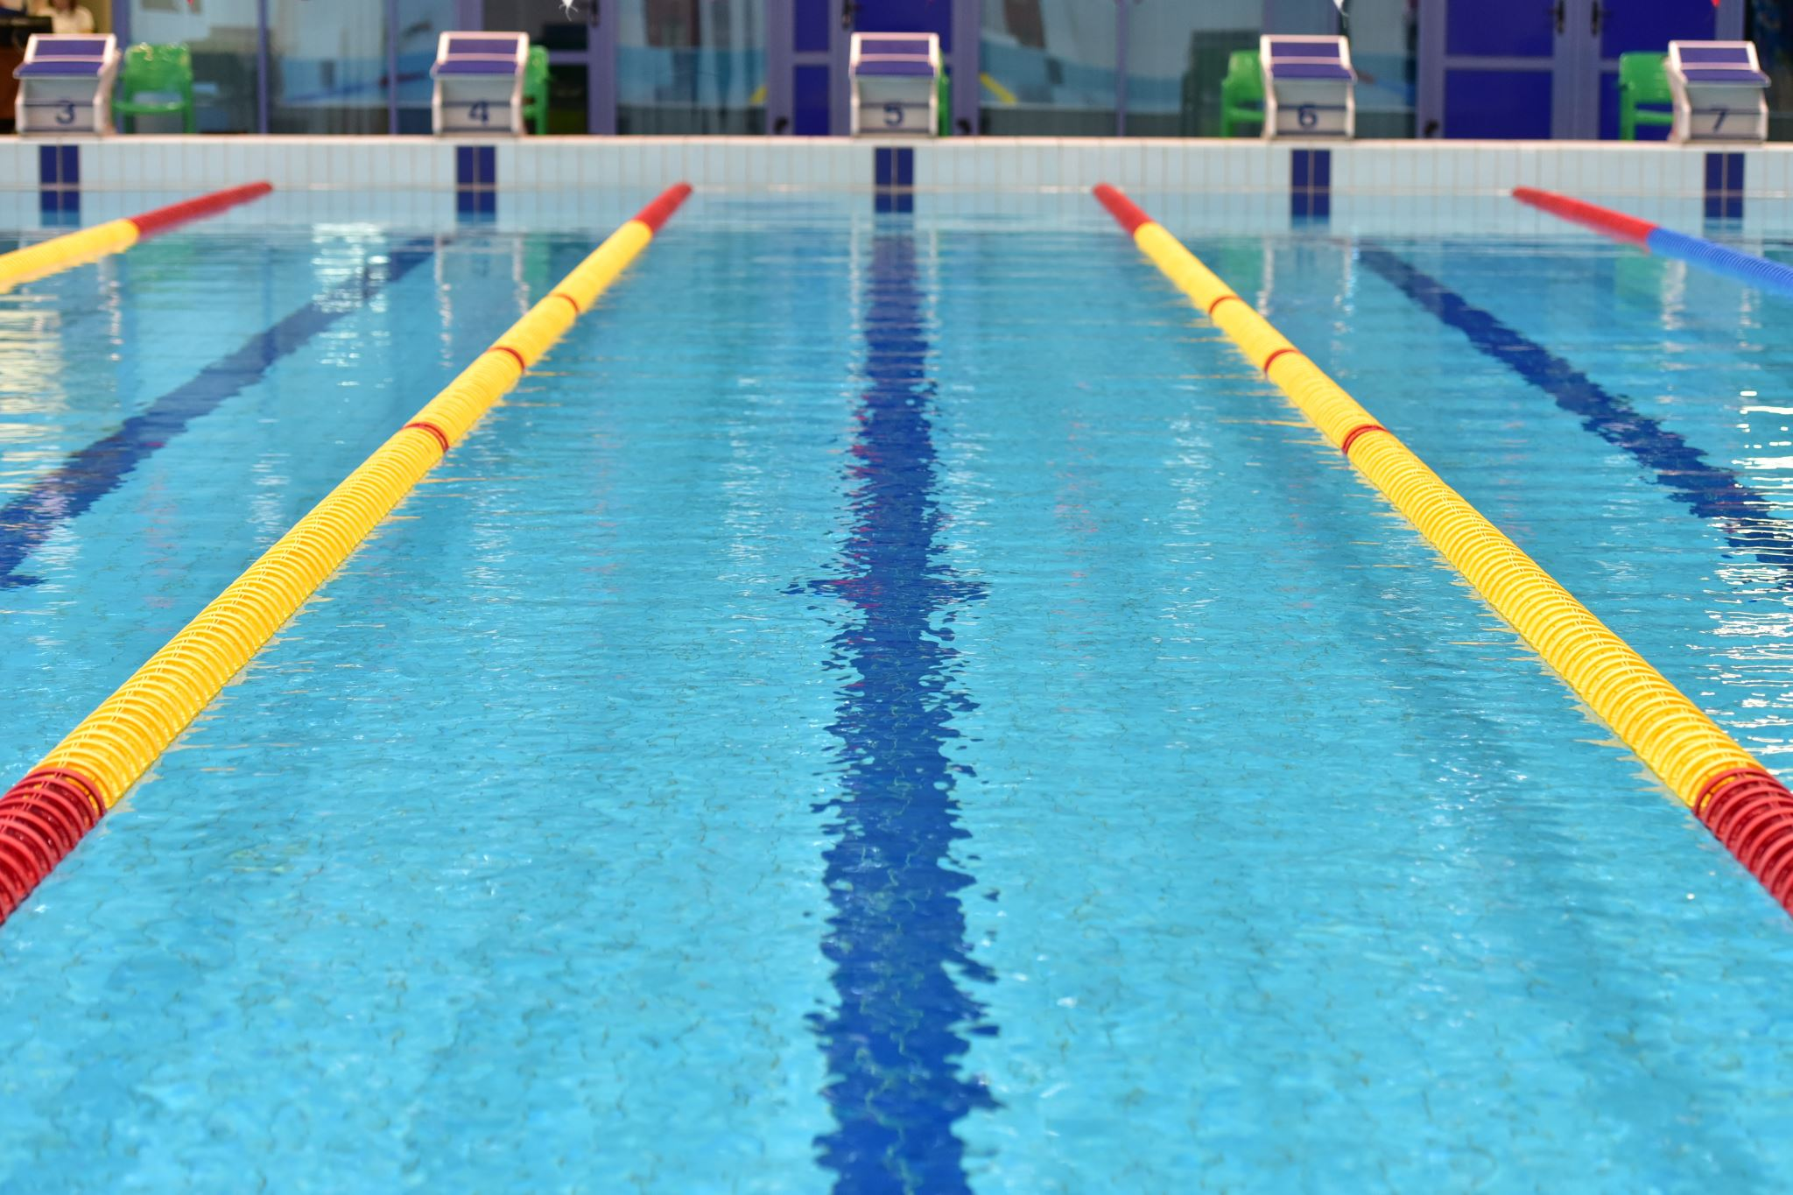
ENTRIES OF COMPETITORS
ENTRIES PER EVENT
- Each delegation may enter an unlimited number of swimmers in individual events but only two swimmers from the same delegation (Country) can compete at the Finals.
- Each swimmer may enter in an unlimited events plus the relays.
RELAY ENTRIES
-Each delegation may enter more than one (1) team in each relay event, but only one (1) team from the same delegation (Country) can compete at the Finals.
Notes:
For the 2024 Gymnasiade there is no quota for participation in individual events.
So, each delegation may enter an unlimited number of swimmers in individual events but only two swimmers from the same delegation (Country) can compete at the Finals.
End each swimmer may register in as many events as he likes, Plus all the 3 relay events.
For the Relay Entries, each delegation may enter more than one (1) team in each relay event for the Qualifying races but only one (1) team from the same delegation (Country) can compete at the Finals.

Slide 5
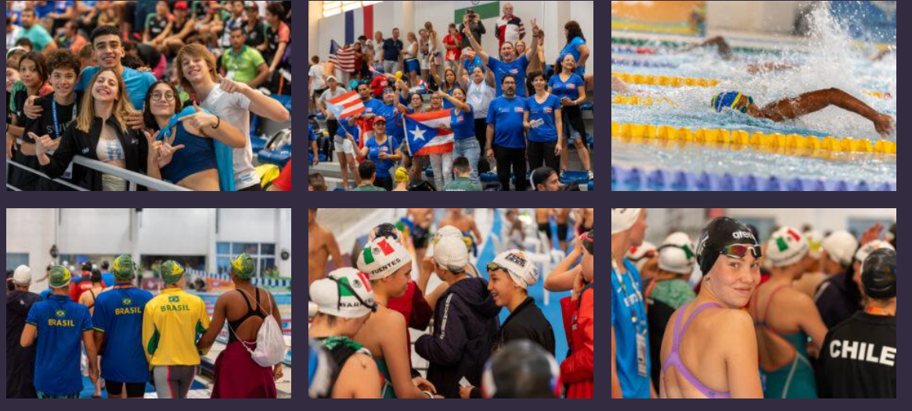
Officials Registration
Officials
- There is no limit in registration to the number of team Officials per country.
Coaches
-Each delegation may enter an unlimited number of coaches
- Each delectation may enter a minimum of 1 coach per gender
ADDITIONAL ADULTS
-The number of additional adults is unlimited.
Notes:
Again, for the 2024 Gymnasiade there is no limit in registration to the number of team Officials per country.
The same with coaches there is an unlimited number of entries from each Country and furthermore, each delectation may enter a minimum of 1 coach per gender.
There is an Unlimited participation for additional Adults also for each Country.

Slide 6
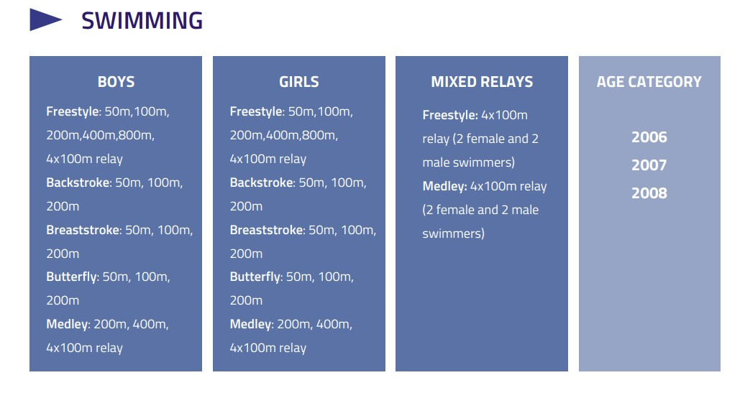
COMPETITIONS INFORMATION PROGRAMME OF EVENTS
-The competition is held over 4 to 5 days.
-All events will be Preliminary Heats and Finals.
Notes:
In the Swimming programme we have 32 individual events, 16 for Boys and 16 for Girls
The Individual Events are………….
We also have 6 Team relay events that give to the Competitions more competitiveness and exciting atmosphere.
So We have the 4*100 Freestyle and 4*100 medley for Boys and girls.
Additionally, of course we have also the new World Aquatics Mix Gender team event which is the 4*100 Mix Freestyle and the 4*100 Mix Medley relay event.
In the Mixed relay event, the team is consisted by 2 Boys and 2 Girls.
Overall, we 38 Events for Men and Women.
Age Category will be Boys and Girls born in 2008, 2007 and 2006.
-The competitions are going to be held over a 4 or maybe 5 days competition programme.
-All events will be contacted in Preliminary Heats and Finals.

Slide 7
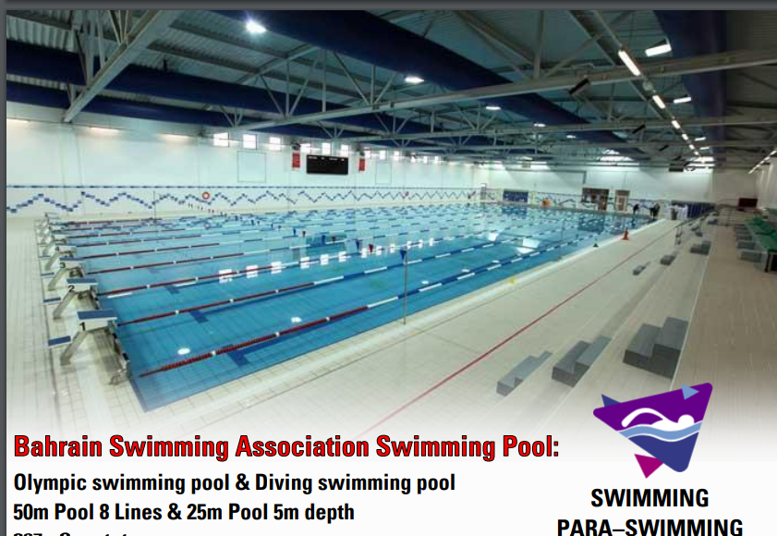
COMPETITION VENUE
Notes:
The Swimming venue for Bahrain Gymnasiade is located in Khalifa Sport City.
Its A Beautiful and well equipped indoor 50-meter 8 lanes swimming pool with a 25 meter 6 lanes warm up pool in the same Building area.
So, the athletes will have the opportunity to compete in a modern well-equipped sports facilities in Bahrain.

Slide 8
Events program by day Heats in the Morning 9.30am and Finals in the Afternoon 5.00pm
Friday 25th | Saturday 26th | Sunday 27th | Monday 28th | Tuesday 29th
200m freestyle | 200m Butterfly | off | 800m Freestyle afternoon Final | 100m Butterfly
100 Backstroke | 100m Breastroke | off | 200m Individual Medley | 400m Freestyle
400m Individual Medley | 50 Backstroke | off | 100m Freestyle | 200m backstroke
50m Breaststroke | 800m Freestyle Morning Heats | off | 200m breastroke | 50m Freestyle
4*100 Freestyle | 4*100 Medley | off | 50m Butterfly | 4*100 Mix Medley
 |  |  | 4*100 Freestyle Mix
Notes:
1. the Para swimming programme will be only finals in the Afternoon the events will be in the same order with the classic swimming.
Mr Marcello will give any more information if you have any questions.
2. A training plan for all delegations will be published prior your arrival according to the number of swimmers of each country.
3.The technical meeting will be on the 24th , the time and the place will be announced in later stage.

Slide 9
AWARDS
Medals
-Gold, Silver, and Bronze to the first Three places
-268 Medals in total
-24 Gold for the men's events
-24 Gold for the women's events
-8 gold for the Mixed Relays events.
Diploma of Honour
-for all eight finalists in both individual and Team events.
Participation Diploma
For all participants
FARE PLAY AWARD
-Team OR Individual Trophy
Notes:
For the Swimming events we will ward to Students-athletes 268 medals in total.
24 Gold medals for the men's events,
24 Gold medals for the women's events,
And 8 gold for the Mixed Relays events for men and Women together.
All eight finalists in both individual and relay events will receive a Diploma of Honour
And all Participants in Swimming events we receive a Participation Diploma.
Finally, the Swimming Technical committee will present the Fare play award to the athlete , or team or coach that had an overall fare play- sportsmanship behaviour during the Competitions.

Slide 10
SWIMMING RULES -The Competitions will be held under the World Aquatics (Fina) Rules and Regulations in force at the time of the Event (2023-2025)
TECHNICAL OFFICIALS
According to FINA rules (World Aqatics)
COMPETITION EQUIPMENT and FACILITIES
Approved by Fina (World Aquatics) and according to FINA FACILITIES RULES 2021– 2025
Notes:
Off course the Competitions will be held under the World Aquatics (Fina) Rules and Regulations in force at the time of the Event.
Know and until 2025 we have the (2023-2025) FINA rule book in place.
The same rules will apply also for the Technical officials
The competition equipment and facilities will be accordance with the 2021 -2025 FINA FACILITIES RULES.

Slide 11
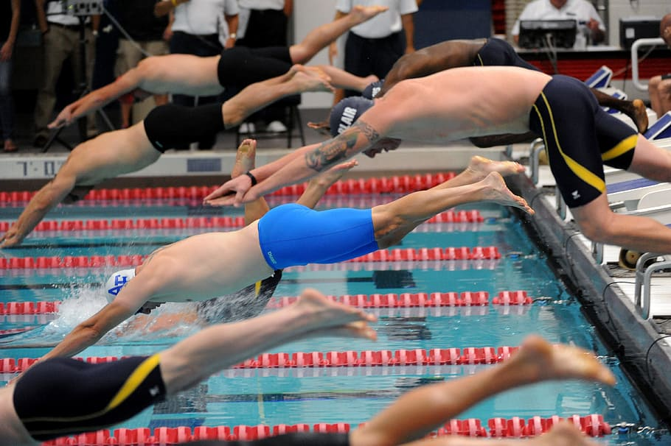
Past ISF Gymnasiades Swimming Entries Information
ISF U18 Gymnasiade Normandy 2022, 263 Athletes and 34 coaches from 24 Countries
ISF U15 Gymnasiade Rio De Janeiro 2023 257 Athletes and 52 coaches /officials from 20 Countries.
Notes:
Information data for the Past 2 Gymnasiades.
The Swimming Entries for Normandy U18 Gymnasiade in 2022 was 263 Athletes and 34 Coaches from 24 Countries and for the Rio de Janeiro U15 Gymnasiade this past Summer was 257 Athletes and 52 coaches and officials from 20 Countries.
For Bahrain we are aiming, to have more than 350.

Slide 12
Thanks a lot! Hope to see you all in Bahrain! Questions?
Contact information
Alexis Kyriakides
Swimming TC President
Email:Kalexis74@gmail.con
WhatsApp: 0035799426230

